Slide 1

COMP1516
Lesson 5: Lists

Slide 2
Topics
Containers
Tuples
Tuple: multiple return from function
Lists
Lists and loops
List functions and methods
Lists of lists
List Comprehensions
Mutable Operations

Slide 3
Containers
In python, related data can be grouped together into a single variable.
For example, instead of declaring one string variable to store the name of a single province, we could declare a container variable to store all of the names of all Canadian provinces.
There are four container types in python:
- tuple
- list
- set
- dictionary.
This lesson examines the first two: tuples and lists.

Slide 4
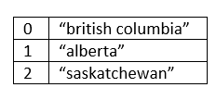
Tuples
A tuple contains an ordered sequence of elements (e.g. a bunch of strings for the names of the Canadian provinces).
Duplicate elements are allowed.
Elements are automatically given an index, beginning from zero.
Tuple elements cannot be added, removed, or updated once declared (“immutable”).
Tuples use ( parentheses ).
Example:
provinces = () # empty tuple; very rare to do this
canadian_provinces = (“british columbia”, “alberta”, “saskatchewan”)

Slide 5
Tuples: Functions and Methods
canadian_provinces = (“british columbia”, “alberta”, “saskatchewan”)
[ Square brackets ] give access to individual elements in tuples.
print(canadian_provinces[1]) # alberta
print(canadian_provinces[3]) # Exception: IndexError
print(len(canadian_provinces)) # 3
car_makers = (“dodge”, “ford”, “honda”, “toyota”, “dodge”)
print(car_makers.count(“dodge”)) # 2; there are 2 instances of “dodge”
print(car_makers.count(“ford”)) # 1
print(car_makers.count(“lamborghini”)) # 0

Slide 6
Tuple: Multiple Return
Functions only permit one return value, but with a tuple we can return several at once.
def get_name_from_user(): first = input("What is your first name? ") middle = input("What is your middle name? ") last = input("What is your last name? ") return (first, middle, last) # a tuple; notice the parentheses
full_name = get_name_from_user() # full_name is a tuple of three strings
print("Your full name is %s %s %s" % (full_name[0], full_name[1], full_name[2]))
OUTPUT:
What is your first name? tiger What is your middle name? tont What is your last name? woods
Your full name is tiger tont woods

Slide 7
Lists
A list is a mutable tuple.
If you do not want nor expect your container data to change, then use a tuple.
If you want or expect your container data to change, then use a list instead.
Tuples use ().
Lists use [].
Lists have more functions and methods than tuples, because elements can be removed, added, and updated: https://docs.python.org/3/tutorial/datastructures.html

Slide 8
Lists and Functions and Methods
letters = []
letters = ["a", "b", "x", "y", "z"]
letters.pop() # removes the last element: z
letters.remove("y") # removes the first instance of y
letters[2] = "c" # the third element (x) is updated to become c
letters.append("d") # appended to the end of the list
letters.append("e")
more_letters = ["f", "g", "h", "i", "j", "k"]
all_letters = letters + more_letters # joins together (“concatenates”) multiple lists with the plus + sign
print(all_letters) # ['a', 'b', 'c', 'd', 'e', 'f', 'g', 'h', 'i', 'j', 'k']

Slide 9
Lists and Loops
i = 0
while i < len(all_letters): print("letter is %s\n" % all_letters[i]) i+=1
letter is a letter is b letter is c letter is d letter is e letter is f letter is g letter is h letter is I letter is j letter is k

Slide 10
List Functions and Methods
countries = [“japan”, “canada”, “china”, “mexico”, “england”, “greenland”]
print(min(countries)) # canada
print(max(countries)) # mexico
print(countries.index("england")) # 4
print(countries.count("iceland")) # 0 since it appears 0 times
print(countries.count("canada")) # 1 since it appears 1 time

Slide 11
Lists of Lists
row_0 = ["a", "b", "c", "d", "e", "f", "g", "h"] row_1 = ["i", "j", "k", "l", "m", "n", "o", "p"] row_2 = ["q", "r", "s", "t", "u", "v", "w", "x"] row_3 = ["y", "z"]
table = [row_0, row_1, row_2, row_3]
number_of_rows = len(table)
i = 0 while i < number_of_rows: print("Row %d" % (i), end=':: ‘) number_of_letters_in_this_row = len(table[i]) j = 0 while j < number_of_letters_in_this_row: print((table[i][j]), end=' ‘) j+=1 print() i+=1
Row 0:: a b c d e f g h Row 1:: i j k l m n o p Row 2:: q r s t u v w x Row 3:: y z

Slide 12
List Comprehensions
A list comprehension is a shorter way to create a new list, from another list, based upon conditions that you set.
provinces = ["british columbia", "alberta", "saskatchewan", "manitoba", "ontario", "quebec"]
provinces_with_e = [province for province in provinces if "e" in province]
# provinces_with_e = [x for x in provinces if "e" in x]
print(provinces_with_e) # ['alberta', 'saskatchewan', 'quebec’]
Here, each element of provinces takes a turn becoming the new variable called “province”. If that element contains the letter e, it is appended to the new list provinces_with_e.

Slide 13
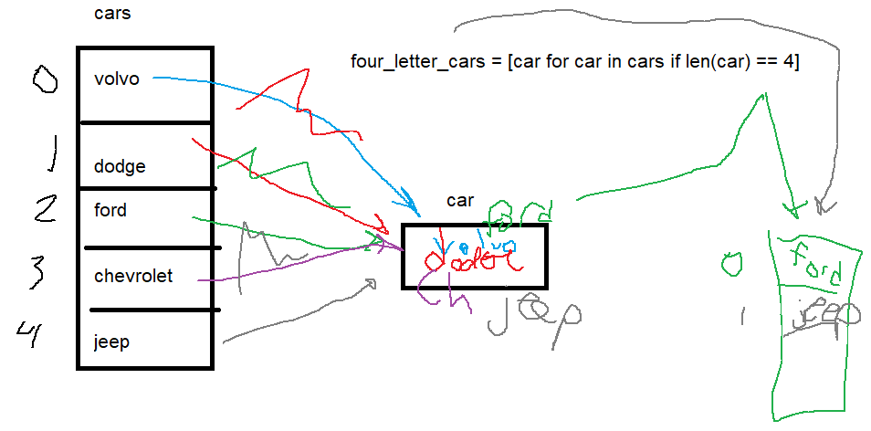
List Comprehensions

Slide 14
List: Mutable Operations
cities = [‘vancouver’, ‘surrey’, ‘burnaby’, ‘nanaimo’, ‘victoria’, ‘port hardy’]
island_cities = cities[3:6]
print(island_cities) # nanaimo, victoria, port hardy
del cities[1] # surrey is deleted
print(cities) # vancouver, surrey, burnaby

Slide 15
List: Mutable Operations
cities = [‘vancouver’, ‘surrey’, ‘burnaby’, ‘nanaimo’, ‘victoria’, ‘port hardy’]
cities.extend([‘tsawwassen’, ‘coquitlam’]) # adds these to the end of cities
cities.insert(1, ‘delta’) # puts delta before surrey and after Vancouver
removed_city = cities.pop(0) # Vancouver is removed and stored in removed_city
cities.sort()
print(cities)
cities.reverse()
print(cities)

